Slide 1
Tips for Use
Click New Slide to add another blank starter template page
To color the Source location box, click Shape Fill drop down, then select eyedropper and click on your mineral to color the box the same as a color in your mineral
For photos, I have been just using my iphone changing to Square photo, then using the 2 x zoom and photographing them in the sunshine outside to reproduce the best natural color
I use eBay to search and find comparable specimens to get a good gauge of current value
I use www.webminerals.com and https://www.mindat.org/ and Google/wikipedia to add in the all of the mineral data into my sheets
Make sure and save as you go so that you do not lose your work if something crashes
I have left a couple of my specimen pages as examples for you to see the content that I use in each field and how I color the source location box to match the mineral specimen
I still need to develop an index process and figure out how to do the photography the right way and lastly what UV lighting I need to best determine flouresence.
For help or to provide feedback, contact us through the MMS website

Slide 3
Creedite
Source: Mina Navidad, Municipio de Rodeo, Durango, Mexico
Crocoite
Ca₃SO₄Al₂F₈(OH)₂ · 2H₂O
Chromian (aka Kammererite)
Vitreous
88 grams
4
6 x 6 x 6 cm
Halide
Small Cabinet
Transparent
Brittle
Perfect
Orange, floater cluster of crystals forming a spiky ball with several small light green Flourite crystals
TBD
October 2015
Monoclinic – Short prismatic crystals radiating from the center
Purchased from Harris Precht Minerals at a Fall Michigan Mineralogical Society show
None
Named after the type locality, in the Creede quadrangle, Colorado
None
None
Upper portions of a fluorite-baryte vein
300 (Paid $250)
Based on eBay comparable specimens May 2020

Slide 4
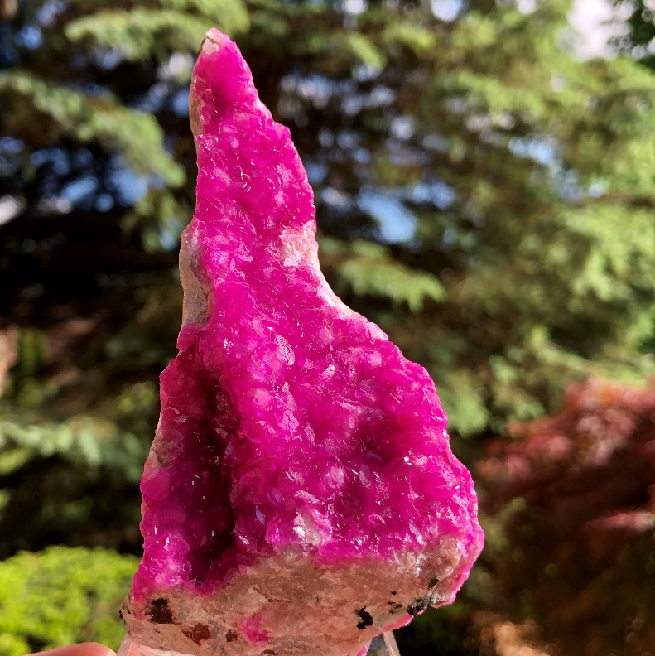
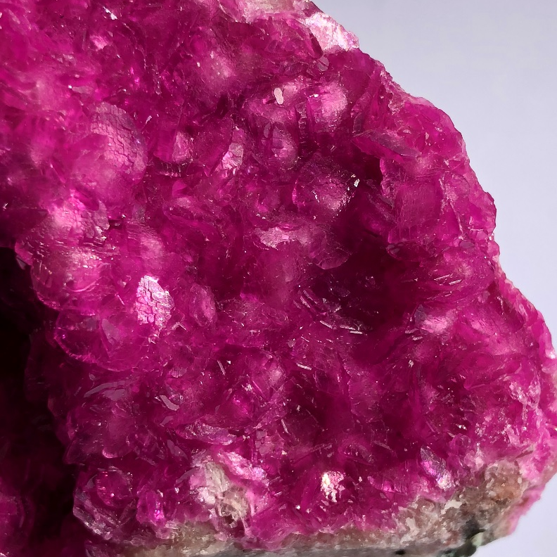
Calcite var. Cobaltoan
Source: Kambove mine, Democratic Republic of Congo, Africa
Calcite
(Ca,Co)CO₃
Cobaltoan
Vitreous, Resinous, Waxy, Pearly
TBD
3
11 x 5 x 4.5 cm
Carbonates (Nitrates)
Small Cabinet
Transparent, Translucent
Brittle
Perfect
Bright neon pink crystals on matrix
TBD
Oct 2017
Trigonal - Most commonly acute rhombohedrons or prismatic with scalenohedral terminations
Purchased from Malachite & Gems of Africa, Max Mpoyi at the Michigan Mineralogical Society Fall Mineral Show
Calcite - Mined for lime (cement) to limestone and marble building stones and aggregates, agricultural supplements and optical calcite.
A variety of calcite containing Co2+ replacing Ca.
None
None
Found in most geologic settings and as a later forming replacement mineral in most other environments
200 (Paid $200)
Based on eBay comparable specimens May 2020

Slide 5
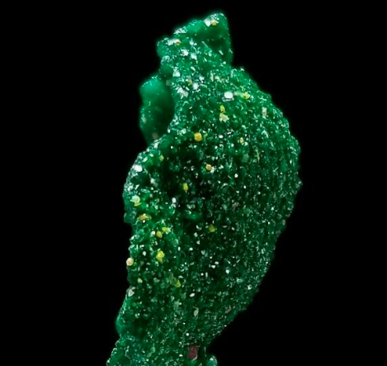
Dioptase
Source: Mindouli, Republic of Congo (Brazzaville), Africa
Republic of Congo (Brazzaville)
Dioptase
CuSiO₃ · H₂O
N/A
Vitreous
TBD
5
5 x 3.2 x 1.5 cm
Cyclosilicates
Small Cabinet
Transparent, Translucent
Brittle
Perfect
Brilliant emerald green Dioptase crystals in a cupped formation which is a relic shape that Dioptase replaced or grew over (likely Plancheite)
No
My 2020
Trigonal - Bright emerald-green modified rhombohedral crystals, usually less than 0.75 cm
Purchased on eBay from Scepter Guy Minerals
None
Tiny yellow Mimimetite crystals can also be found on the back side
None
None
Formed in the oxidized zone of some copper deposits.
200 (Paid $100)
Based on eBay comparable specimens May 2020

